Slide 1
JDBC
Notes:
1
1
Table of Content slide needs to be added.
JDBC Architecture
JDBC Driver Architecture
JDBC API
Connection
Statement
PreparedStatement
CallableStatement
ResultSet
SQLException
RowSet

Slide 2

Table of Content
Objective
JDBC Architecture
JDBC Driver Architecture
JDBC API
Connection
Statement
PreparedStatement
CallableStatement
ResultSet
SQLException
Next
Xoriant Solution Pvt. Ltd.

Slide 3
JDBC Architecture
Java code calls JDBC library
JDBC loads a driver
Driver talks to a particular database
Application
JDBC
Driver
Next

Slide 4
JDBC Drivers
Aspects of Threading
Types :
1
JDBC ODBC Bridge
2
Native-API partly Java technology-enabled driver
Net-protocol fully Java
technology-enabled driver
3
Pure Java driver
4
Next
Xoriant Solution Pvt. Ltd.

Slide 5

Type I Drivers
JDBC-ODBC bridge :
Provides JDBC API access via one or more ODBC drivers.
ODBC native code and native database client code must be loaded on each client machine.
Appropriate when automatic installation and downloading of a Java technology application is not important.
JDBC
Type 1 Bridge
ODBC
ODBC
Driver

Slide 6
Type II Drivers
Native-API partly Java technology-enabled driver.
• Converts JDBC calls into calls on the client API for Oracle, Sybase, Informix, DB2, or other DBMS.
• Requires that some binary code be loaded on each client machine.
JDBC
Type II Native
CLI (.lib)

Slide 7

Type III Drivers
Net-protocol fully Java technology-enabled driver .
Translates JDBC API calls into a DBMS-independent net protocol which is then translated to a DBMS protocol by a server.
The server middleware is able to connect all of its Java technology-based clients to many different databases.
The specific protocol used depends on the vendor.
The most flexible JDBC API alternative.
Middleware Server
JDBC
Type III Middleware

Slide 8
Type IV Drivers
Native-protocol fully Java technology-enabled driver.
Converts JDBC technology calls into the network protocol used by DBMSs directly.
Allows a direct call from the client machine to the DBMS.
Several database vendors have these in progress.
JDBC
Type IV Pure

Slide 9
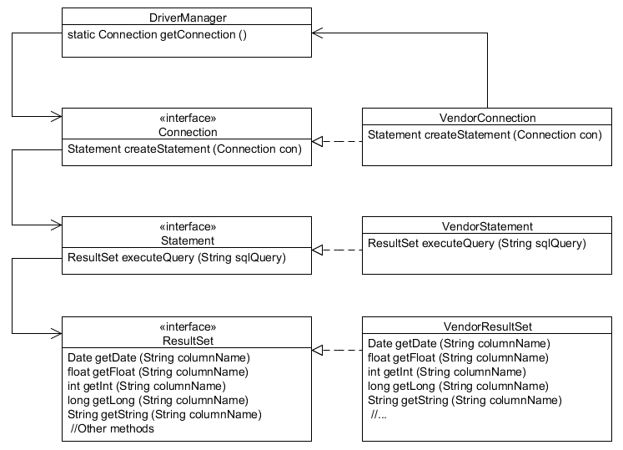
Using JDBC API
Next

Slide 10
Using a Vendor's Driver Class
The DriverManager class is used to get an instance of a Connection object, using the JDBC driver named in the JDBC URL:
The URL syntax for a JDBC driver is:
The URL syntax for an Oracle Thin driver is:
String url = "jdbc:derby://localhost:1527/EmployeeDB";
Connection con = DriverManager.getConnection (url);
jdbc:<driver>:[subsubprotocol:][databaseName][;attribute=value]
Each vendor can implement their own subprotocol.
jdbc:oracle:thin:@//[HOST][:PORT]/SERVICE
Example:
jdbc:oracle:thin:@//myhost:1521/orcl
Next

Slide 11
Key JDBC API Components
Each vendor's JDBC driver class also implements the key API classes that you will use to connect to the database, execute queries, and manipulate data:
java.sql.Connection – A connection that represents the session between your Java application and the database
java.sql.Statement – An object used to execute a static SQL statement and return the result
java.sql.ResultSet – An object representing a database result set
Connection con = DriverManager.getConnection(url, username, password);
Statement stmt = con.createStatement();
String query = "SELECT * FROM Employee";
ResultSet rs = stmt.executeQuery(query);
Next

Slide 12
Using a ResultSet Object
The result of executing a query statement is a set of rows returned in a java.sql.ResultSet object.
String query = "SELECT * FROM EMPLOYEE";
ResultSet rs = stmt.executeQuery(query);
while (rs.next()) {
int empID = rs.getInt("ID");
String first = rs.getString("FIRSTNAME");
String last = rs.getString("LASTNAME");
Date birthDate = rs.getDate("BIRTHDATE");
float salary = rs.getFloat("SALARY");
// other code....
}
ResultSet is automatically closed when the Statement object that generated it is closed.
Next

Slide 13
Putting It All Together
import java.sql.Connection;
import java.sql.DriverManager;
import java.sql.ResultSet;
import java.sql.SQLException;
import java.sql.Statement;
import java.util.Date;
public class SimpleJDBCTest {
public static void main(String[] args) {
String url = "jdbc:derby://localhost:1521/EmployeeDB";
String username = “Scott";
String password = "tiger";
String query = "SELECT * FROM Employee";
try (Connection con = DriverManager.getConnection(url, username,
password)) {
Statement stmt = con.createStatement();
ResultSet rs = stmt.executeQuery(query);
Next

Slide 14
Putting It All Together (Continued)
while (rs.next()) {
int empID = rs.getInt("ID");
String first = rs.getString("FirstName");
String last = rs.getString("LastName");
Date birthDate = rs.getDate("BirthDate");
float salary = rs.getFloat("Salary");
System.out.println("Employee ID: " + empID + "\n"
+ "Employee Name: " + first + " " + last + "\n"
+ "Birth Date: " + birthDate + "\n" + "Salary: "
+ salary);
} // end of while
} catch (SQLException e) {
System.out.println("SQL Exception: " + e);
} // end of try-with-resources
}
}
Back
Next

Slide 15
The SQLException Class
An SQLException is thrown from errors that occur in one of the following types of actions: driver methods, methods that access the database, or attempts to get a connection to the database.
The SQLException class also implements Iterable— exceptions can be chained together and returned as a single object.
SQLException is thrown if the database connection cannot be made due to incorrect username or password information, or simply the database is offline.
SQLException can also result by attempting to access a column name that is not part of the SQL query.
SQLException is also subclassed, providing granularity of the actual exception thrown.
Next

Slide 16
Closing JDBC Objects
Closing a Connection object will automatically close any Statement objects created with this Connection.
Closing a Statement object will close and invalidate any instances of ResultSet created by the Statement object.
Resources held by the ResultSet, may not be released until garbage is collected, so it is a good practice to explicitly close ResultSet objects when they are no longer needed.
When the close() method on ResultSet is executed, external resources are released.
ResultSet objects are also implicitly closed when an associated Statement object is re-exectued.
Next

Slide 17
The try-with-Resources Construct
Given the following try-with-resources statement:
try (
Connection con =
DriverManager.getConnection(url, username, password);
Statement stmt = con.createStatement();
ResultSet rs = stmt.executeQuery (query))}
The compiler checks to see that the object inside the parentheses implements java.lang.AutoCloseable
This interface includes one method: void close().
The close method is automatically called at the end of the try block in the proper order (last declaration to first).
Multiple closeable resources can be included in the try block, separated by semicolons.
Next

Slide 18
try-with-resources: Bad Practice
It might be tempting to write try-with-resources more compactly:
try (
try (ResultSet rs = DriverManager.getConnection(url, username, password).createStatement().executeQuery(query))
ResultSet rs = stmt.executeQuery (query))}
However, only the close method of ResultSet is called, which is not a good practice.
Always keep in mind which resources you need to close when using try-with-resources.
Next

Slide 19
Writing Queries and Getting Results
To execute SQL queries with JDBC, you need to create a SQL query wrapper object, an instance of the Statement object.
Note that there are three Statement execute methods:
Statement stmt = con.createStatement();
Use the Statement instance to execute a SQL query:
ResultSet rs = stmt.executeQuery (query);
Method | Returns | Used for
executeQuery(sqlString) | ResultSet | SELECT statement
executeUpdate(sqlString) | int (rows affected) | INSERT, UPDATE, DELETE, or a DDL
execute(sqlString) | boolean (true if there was a ResultSet) | Any SQL command or commands
Next

Slide 20
Using PreparedStatement
PreparedStatement is a subclass of Statement that allows you to pass arguments to a precompiled SQL statement.
double value = 100_000;
PreparedStatement pStmt = con.prepareStatement("SELECT * FROM Employee WHERE Salary > ?");
pStmt.setDouble(1, value);
ResultSet rs = pStmt.executeQuery();
In this code fragment, a prepared statement returns all columns of all rows whose salary is greater than 100,000.
PreparedStatement is useful when you have SQL statements that you are going to execute multiple times.
Next

Slide 21
Using CallableStatement
A CallableStatement allows non-SQL statements (such as stored procedures) to be executed against the database.
CallableStatement cStmt = con.prepareCall("{CALL EmplAgeCount (?, ?)}");
int age = 50; cStmt.setInt (1, age);
ResultSet rs = cStmt.executeQuery(); cStmt.registerOutParameter(2, Types.INTEGER);
boolean result = cStmt.execute();
int count = cStmt.getInt(2);
System.out.println("There are " + count + " Employees over the age of " + age);
Stored procedures are executed on the database.
Next

Slide 22
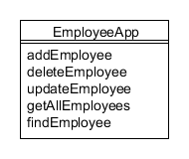
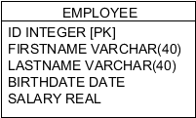
Going Further: Data Access Objects
Consider an employee table like the one in the sample JDBC code.
By combining the code that accesses the database with the "business" logic, the data access methods and the Employee table are tightly coupled.
Any changes to the table (such as adding a field) will require a complete change to the application.
Employee data is not encapsulated within the example application.
Next

Slide 23
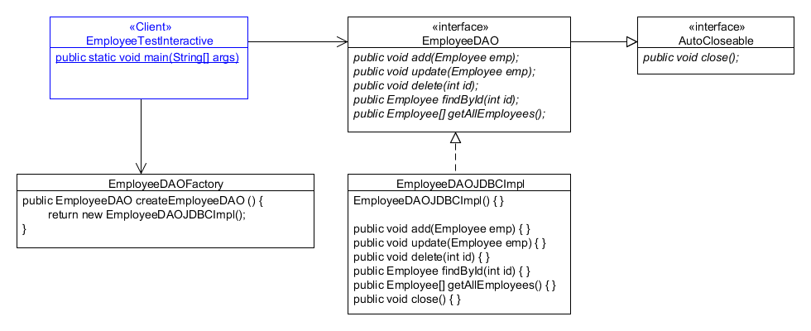
The Data Access Object Pattern
2
1
3
Next

